Slide 1

Operations for directories and files
Copy/move/find files, folders...
1
Operations for directories and files

Slide 2
Overview of operations
Operations
Directories
Common to both
Files
Create
mkdir
Remove
rmdir
Remove
rm
Copy
cp
Move/rename
mv
Find
find
Link
ln
2
Operations for directories and files

Slide 3
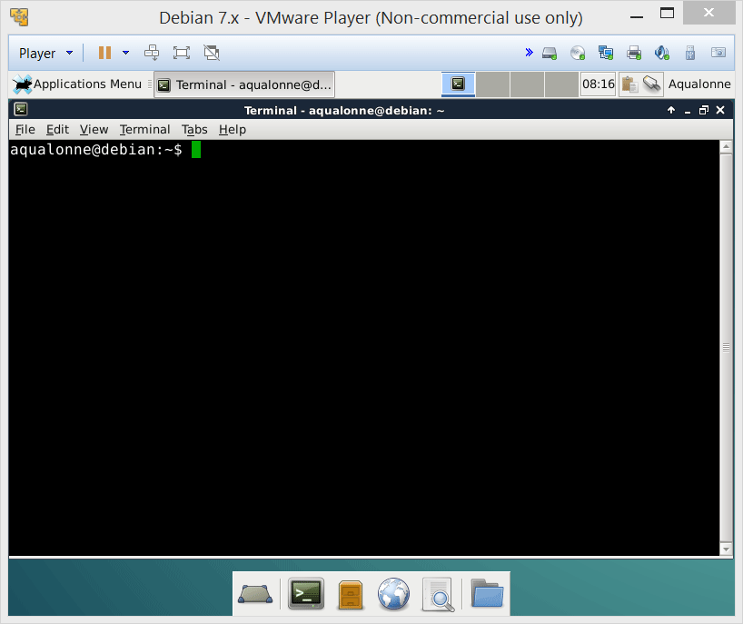
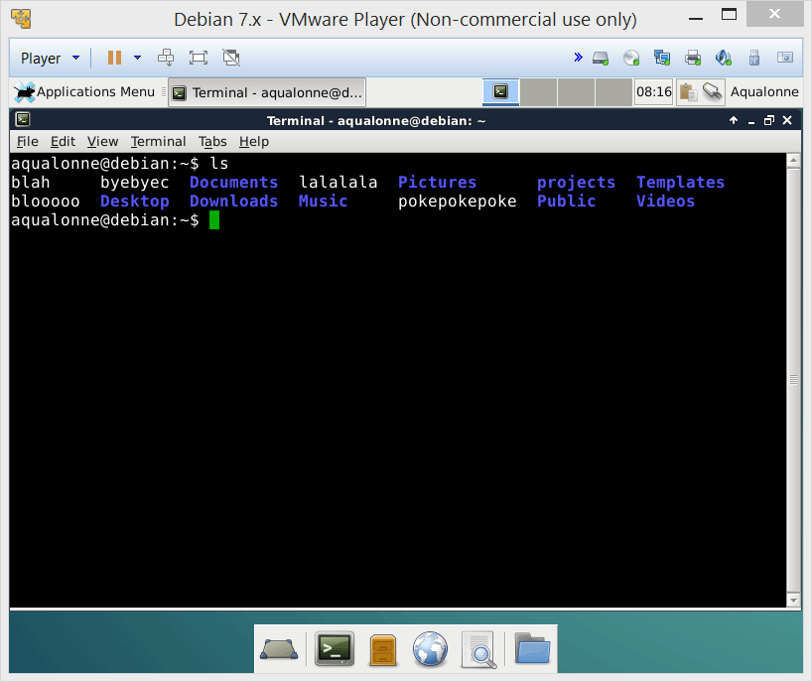
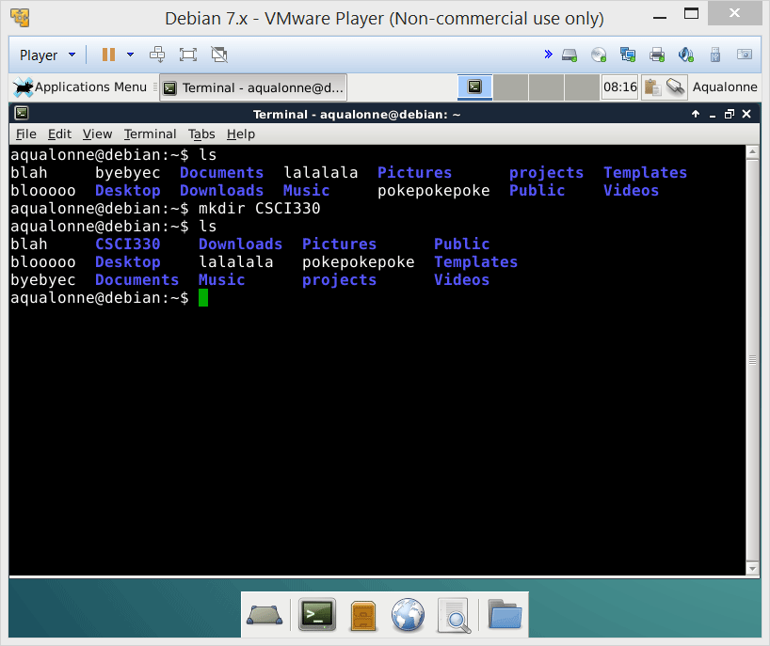

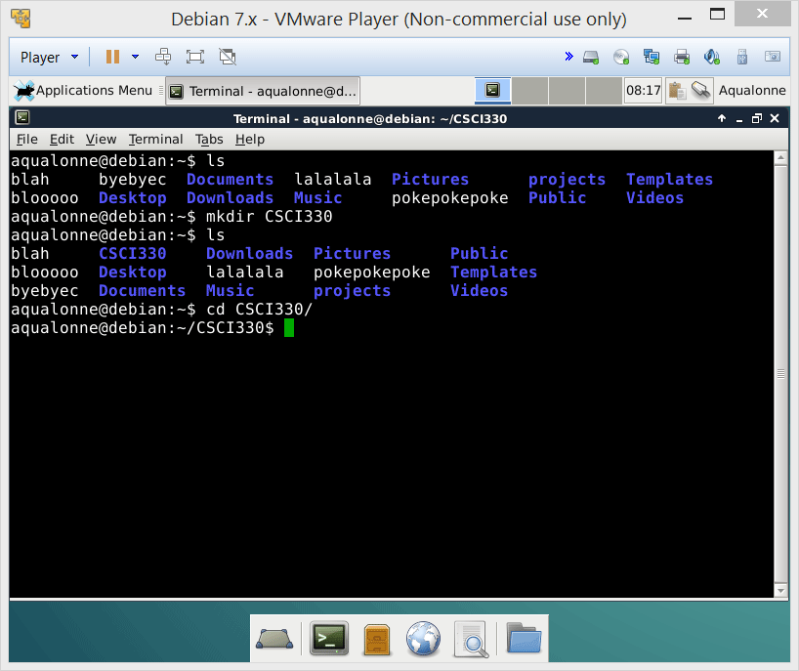
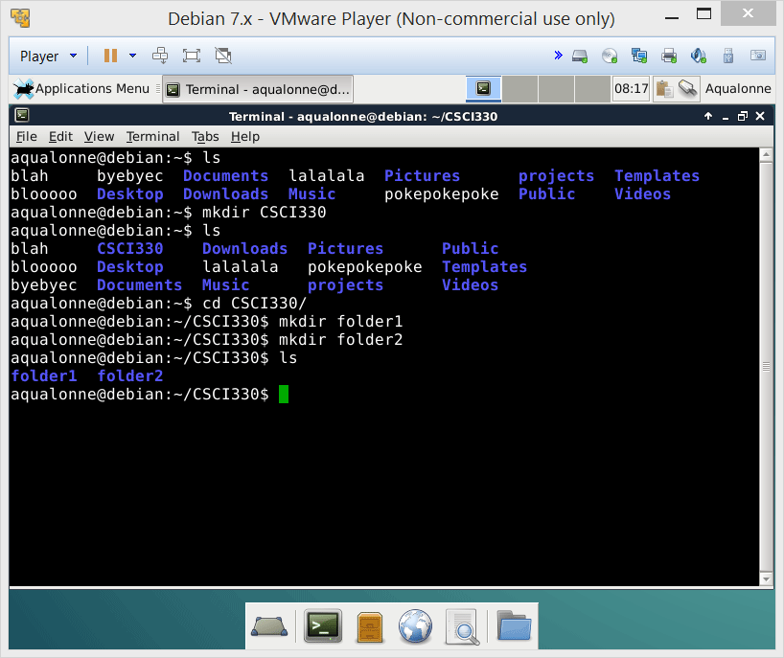
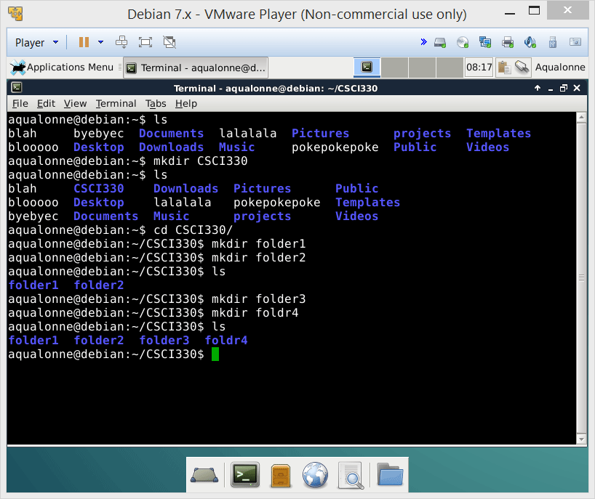
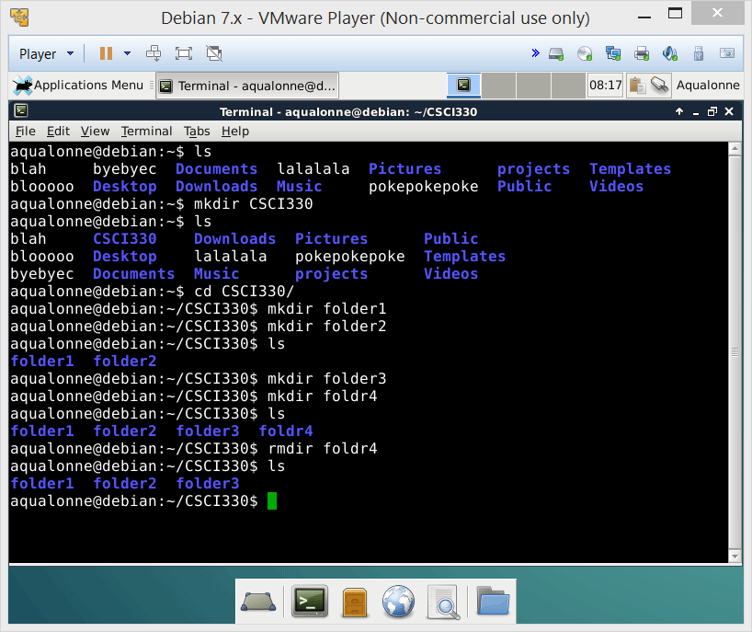
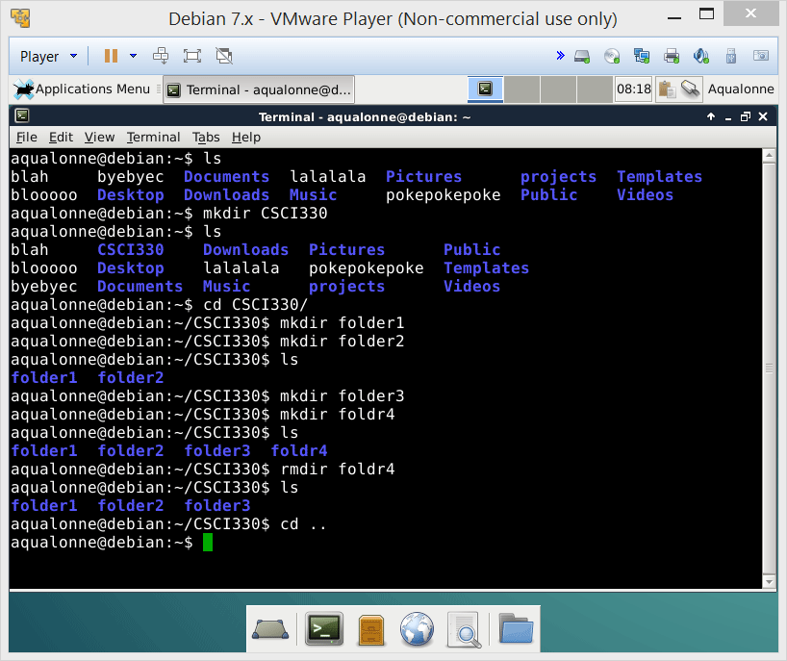
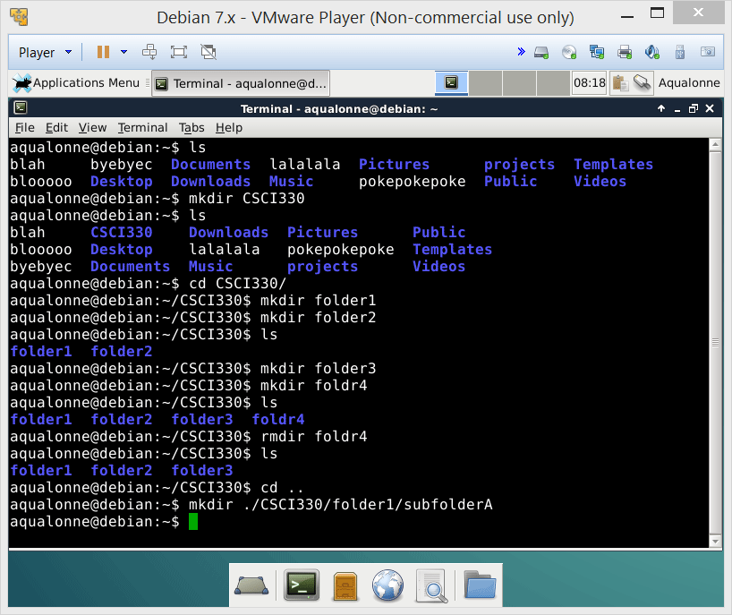
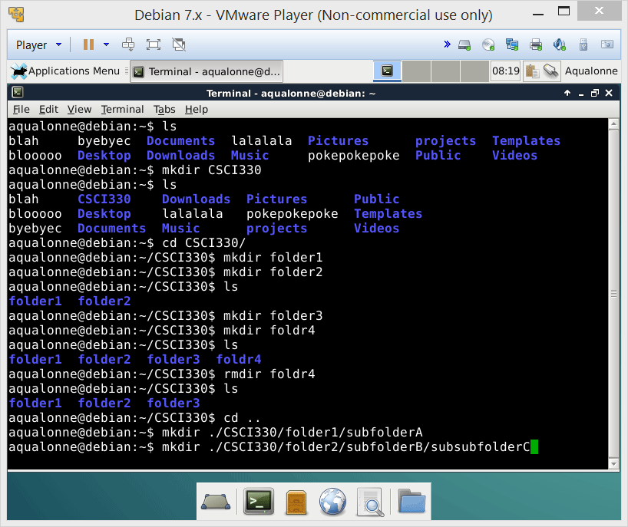
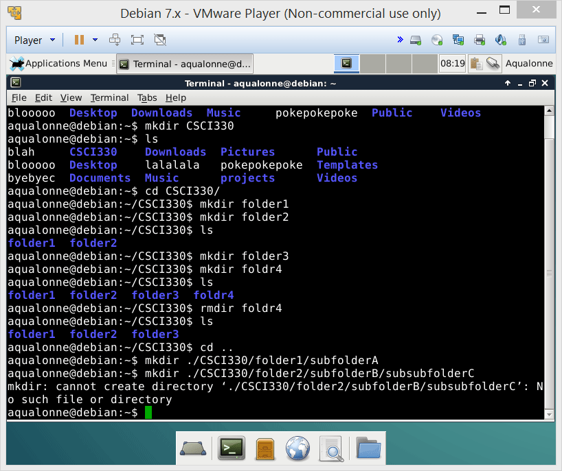
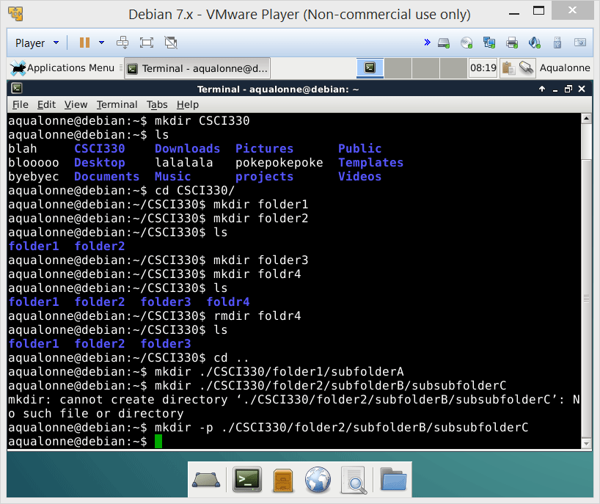
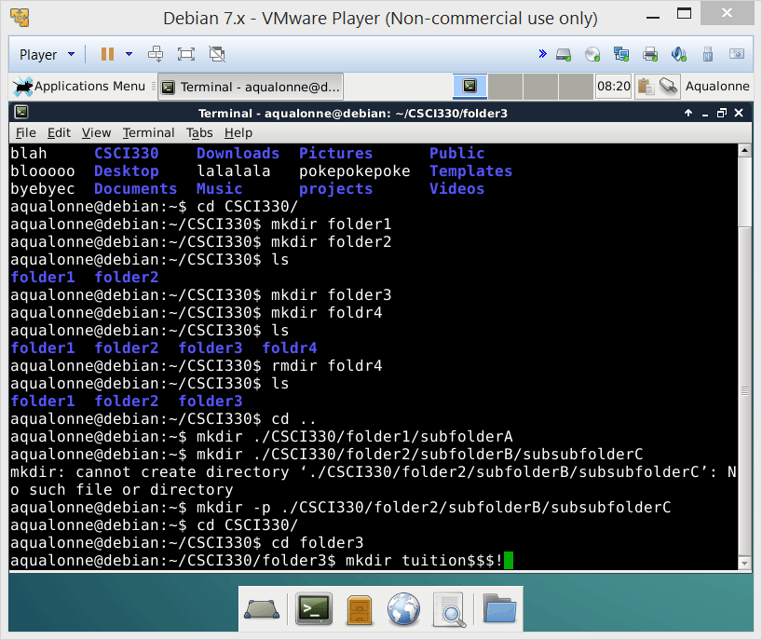
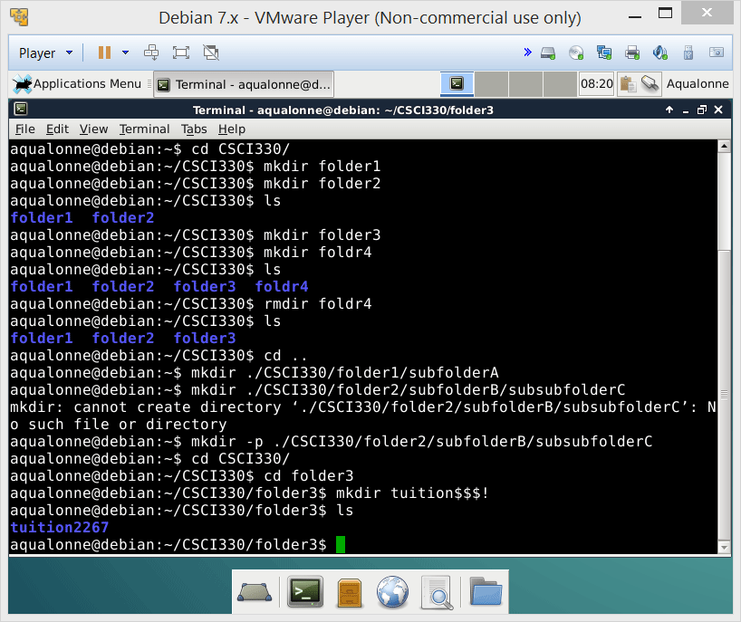
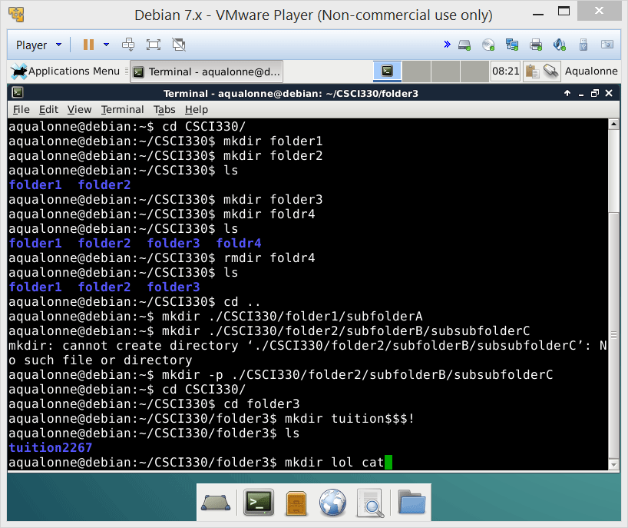
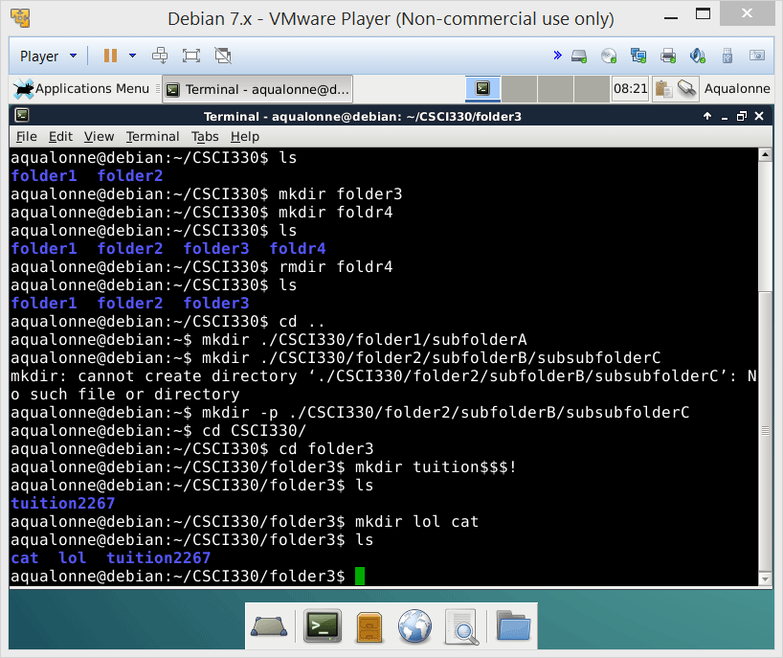
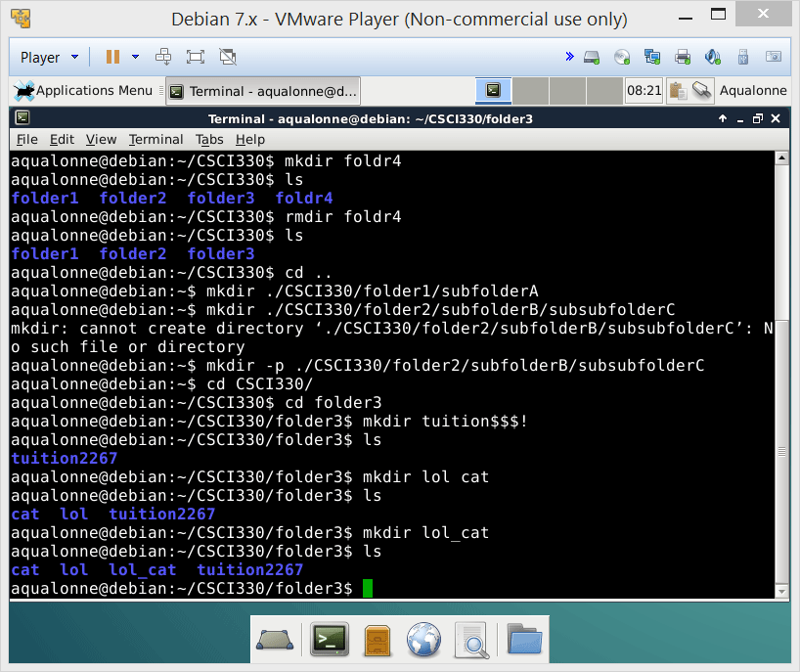
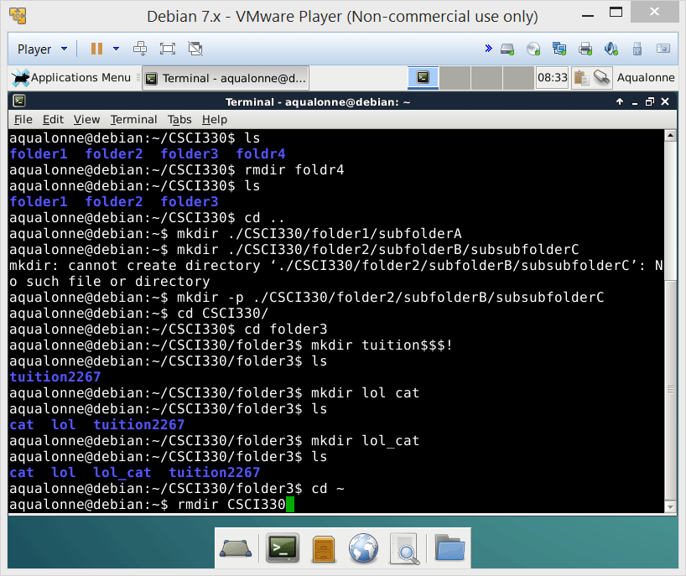
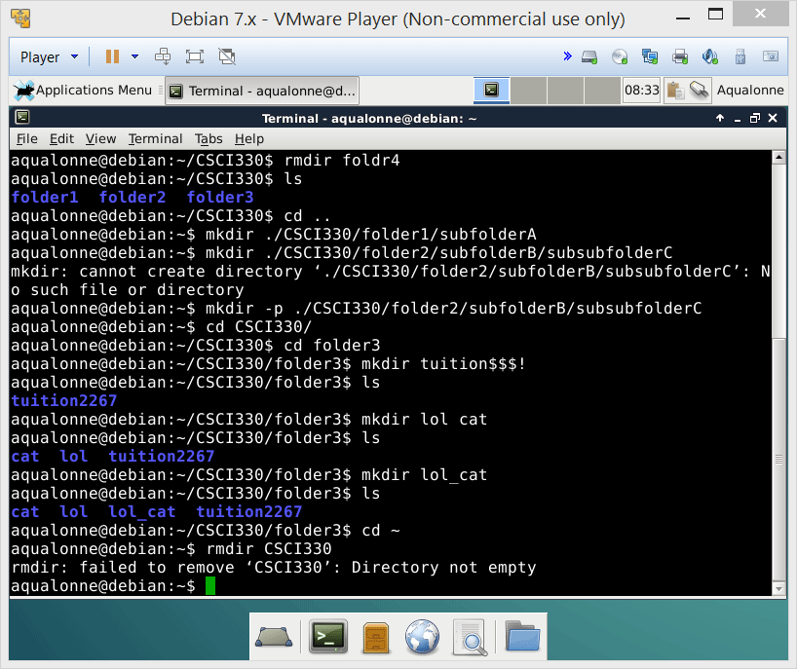

Creating and removing directories
Use the Tab key as often as possible for autocompletion
3
Operations for directories and files

Slide 4
Creating and removing directories
mkdir to make directories
Relative mode: mkdir CSCI330
Absolute mode: mkdir /home/CSCI330
If you need to create intermediate directories, use the –p option as in
mkdir –p /home/CSCI330/folder1/subfolder
4
Operations for directories and files

Slide 5
Creating and removing directories
rmdir to remove empty directories
Relative mode: rmdir CSCI330
Absolute mode: rmdir /home/CSCI330
5
Operations for directories and files

Slide 6


Creating and removing directories
Characters you can use for directories and files
Uppercase letters (A-Z)
Lowercase letters (a-z)
Numbers (0-9)
Underscore ( _ )
Period/dot ( . )
If it’s not allowed, then it’s forbidden!
Brackets [ ] ( ) { }
Quotes “ ‘
Punctuation ? !
Keystrokes tab space
Math < > ^ *
Characters you cannot use for directories and files
6
Operations for directories and files

Slide 7



Creating and removing directories
If you are asked to create multiple directories, go where they start and create them all from there. Do not use cd to go in one, create another...
cd ~
mkdir CSCI
cd CSCI
mkdir 330
cd 330
mkdir Slides
cd..
mkdir 240
cd ~
mkdir -p CSCI/330/Slides
mkdir CSCI/240
~
CSCI
330
Slides
240
7
Operations for directories and files

Slide 8

Overview of operations
Operations
Directories
Common to both
Files
Create
mkdir
Remove
rmdir
Remove
rm
Copy
cp
Move/rename
mv
Find
find
Link
ln
8
Operations for directories and files

Slide 9
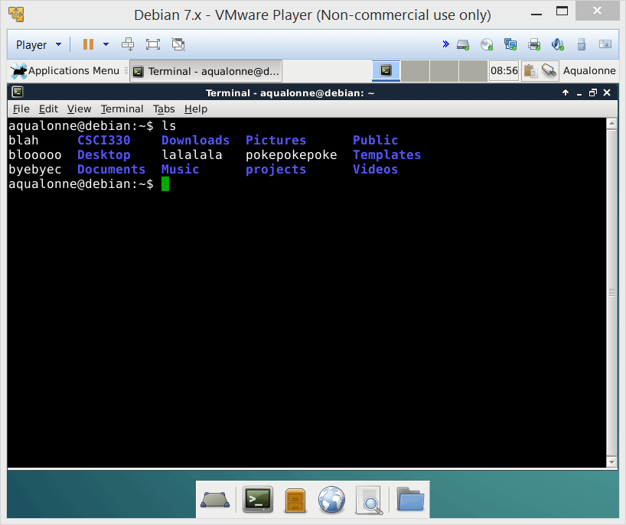
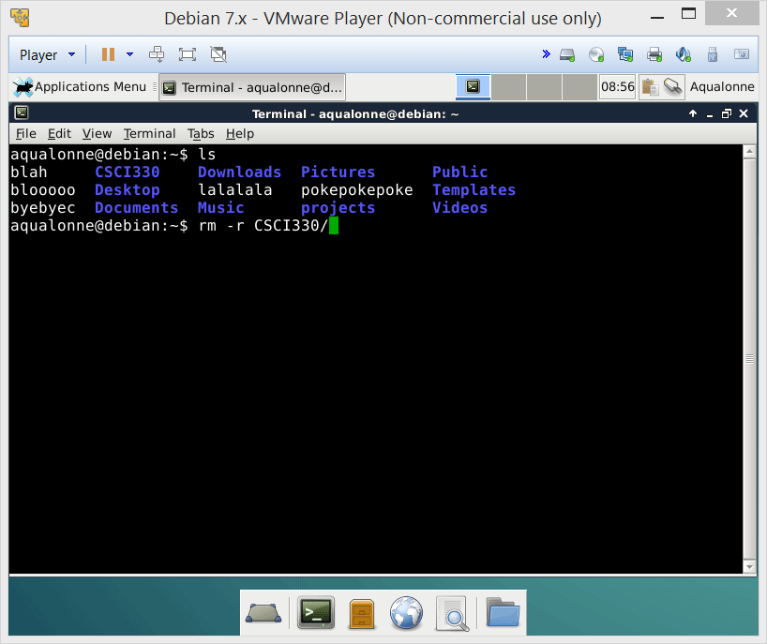
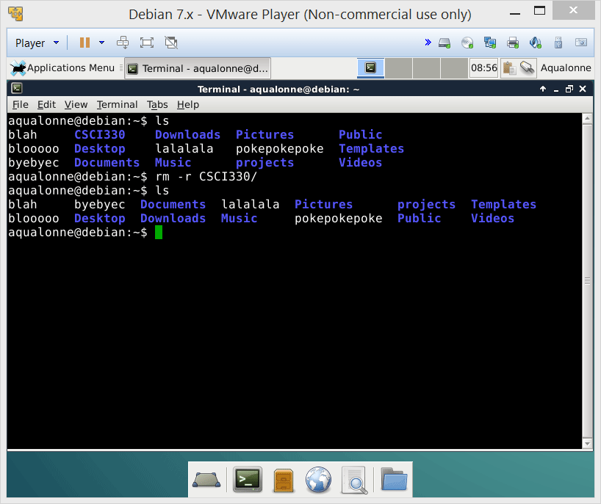
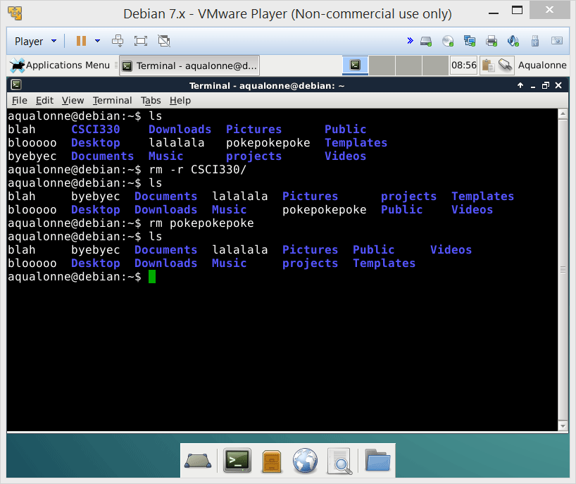
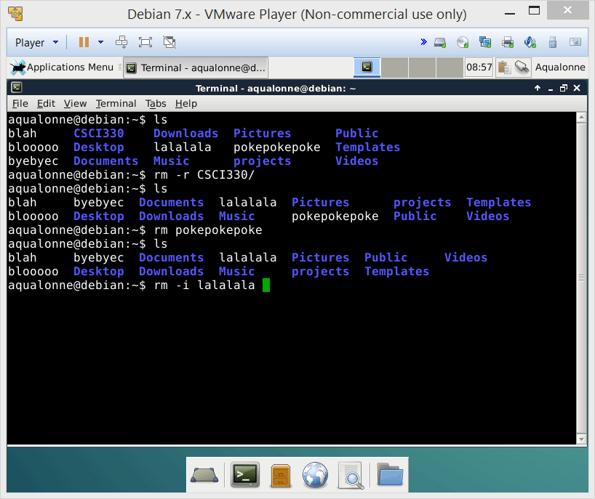
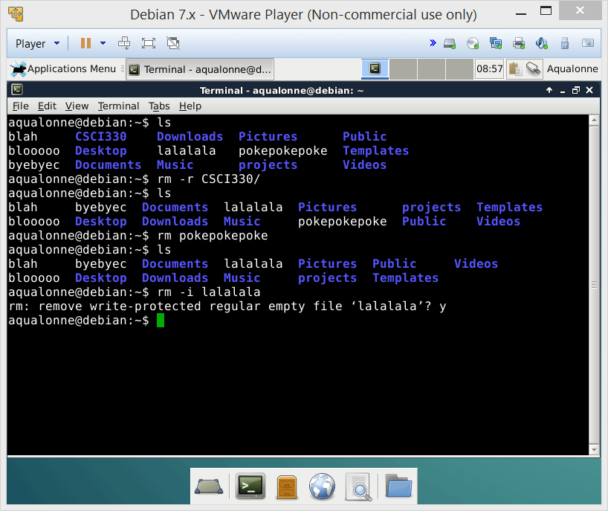
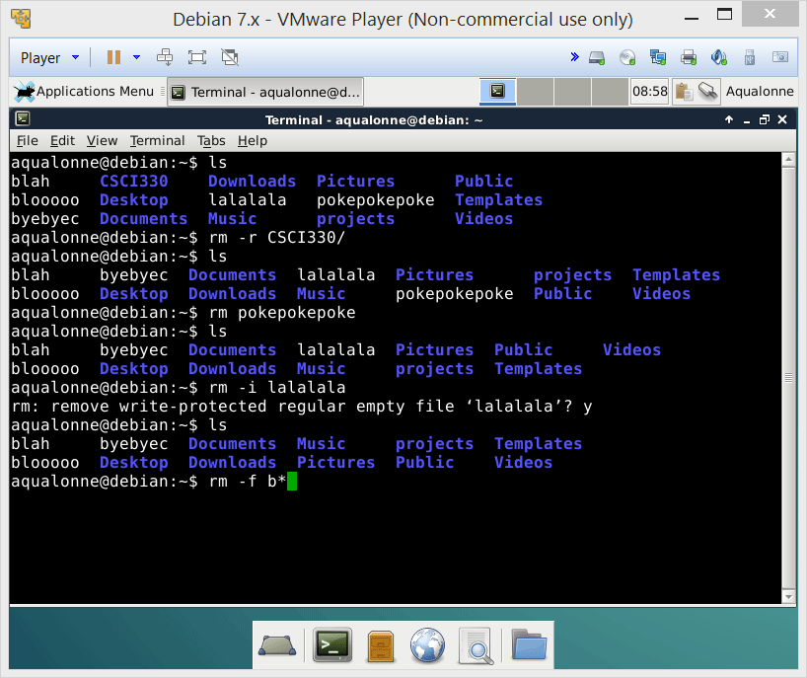
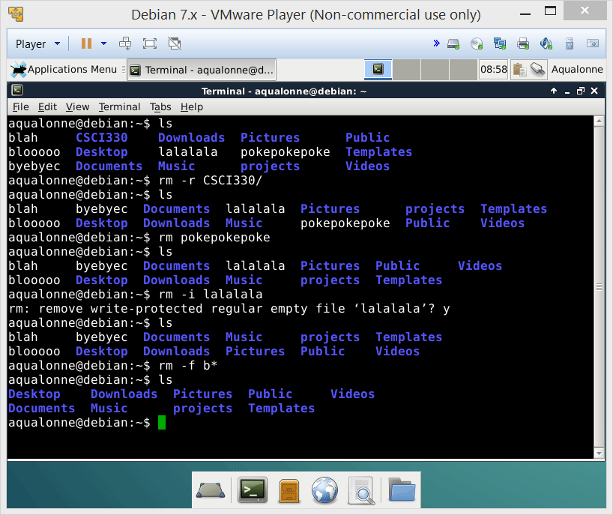
Removing files or directories
9
Operations for directories and files

Slide 10
Removing files or directories
rm to remove anything
-r Recursive remove. Removes a folder and all that’s in it, empty or not. Careful!!
-f Force. Doesn’t ask for confirmation.
-i Asks confirmation before every removal.
-I Asks confirmation before many removals.
10
Operations for directories and files

Slide 11
Removing files or directories
Wildcard characters
They allow for pattern matching. You want to do something on all files/directories whose name follows a specific pattern.
Character | Description | Example
* | Match any number of characters (so zero or more…) | rm *.c
? | Match a single character | rm conf.?
[lower-upper] | Match any character in range | rm lib-id[3-7].o
[list] | Match any single character in list | rm conf.[co]
str{str1,str2,…} | Match any multiple characters in { } | rm c*.{700,300}
11
Operations for directories and files

Slide 12
Removing files or directories
Wildcard characters
Examples
How would you remove all files whose name start with tmp?
rm tmp*
rm *.tmp
How would you remove all files whose name ends with .tmp?
How would you remove all files whose name start with a number?
rm [0-9]*
rm *[xX]
How would you remove all files whose name ends with either X or x?
12
Operations for directories and files

Slide 13
Removing files or directories
The type of a file is defined by what’s inside, not the extension. You’ll see lots of files without extensions.
So don’t ever assume an extension. If you’re told to remove a text file named myText, you do rm myText, you don’t guess extensions like rm myText.txt
The extension is in the same block as the file name (unlike Windows). If you want to remove all files whose names start with data, type rm data*, not
rm data*.*
Requires that the filename contains a dot, which Linux files don’t need!
13
Operations for directories and files

Slide 14

Removing files or directories
Most people know that they shouldn’t do it.
But that may not stop them from doing it anyway.
And then you may be the one dealing with the consequences.
Brackets [ ] ( ) { }
Quotes “ ‘
Punctuation ? !
Keystrokes tab space
Math < > ^ *
Characters you cannot use for directories and files
14
Operations for directories and files

Slide 15
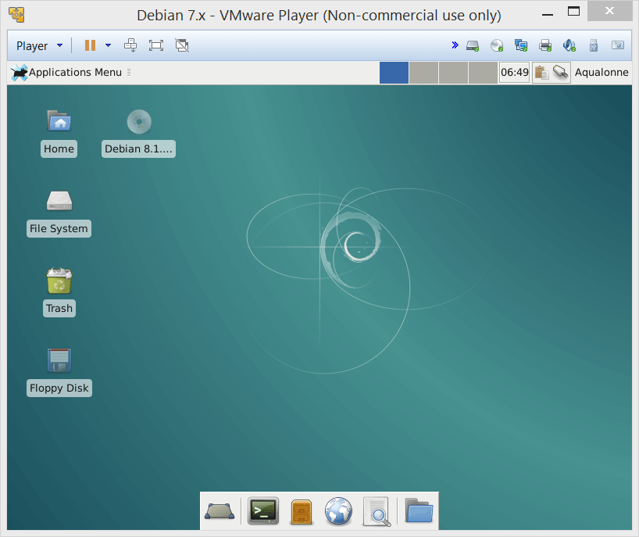
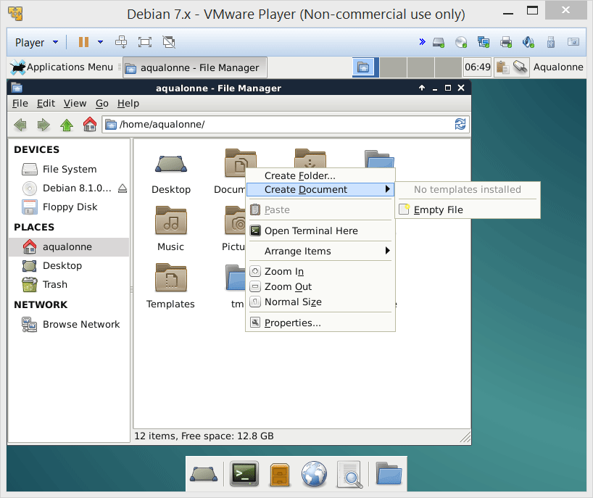
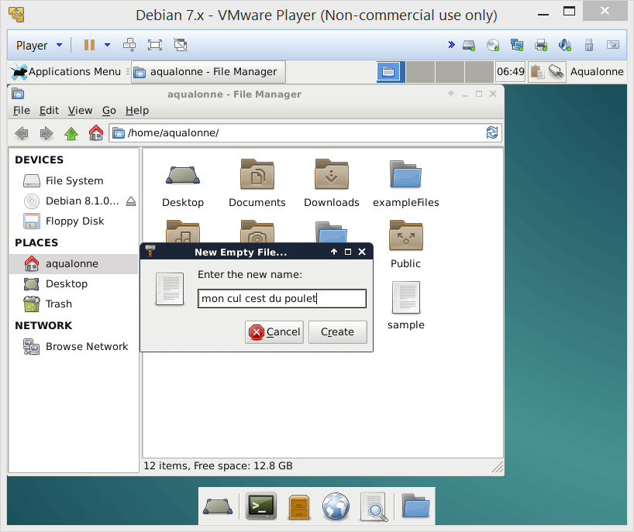
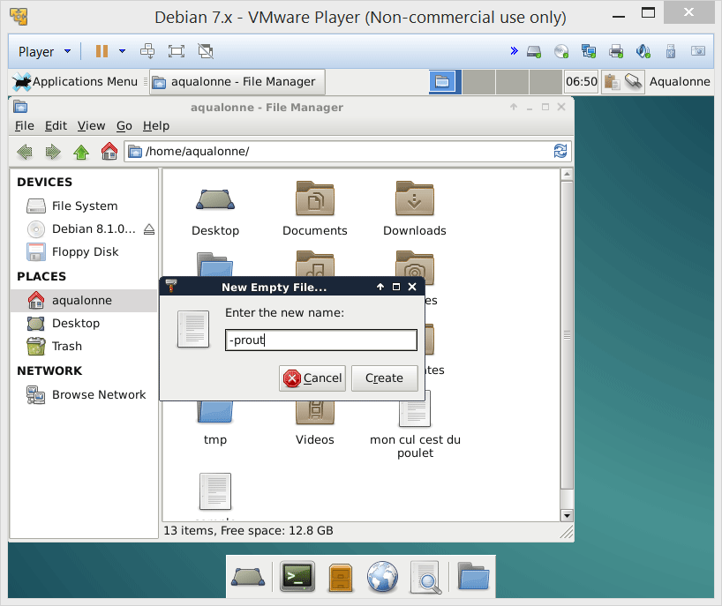
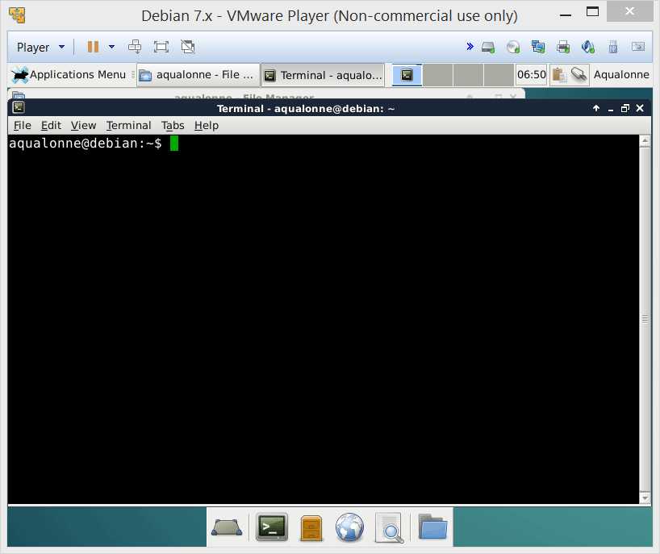
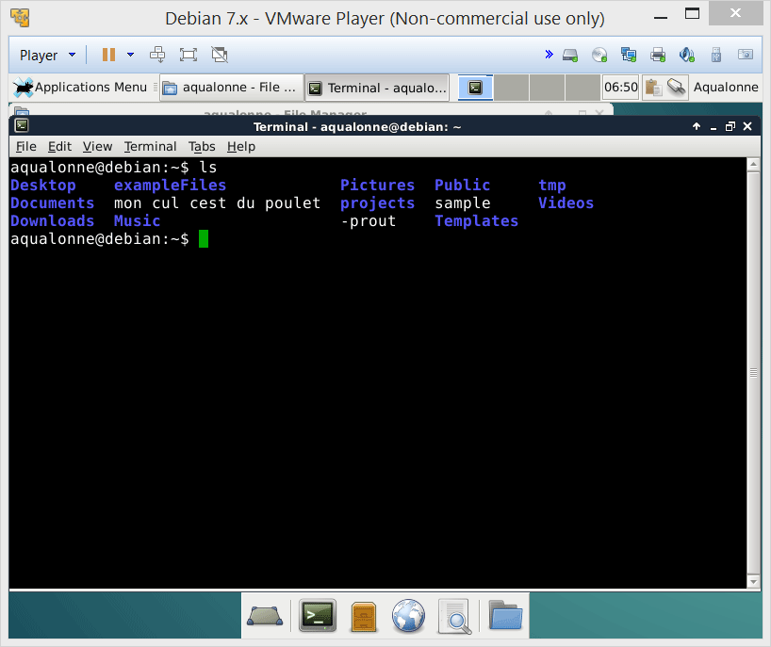

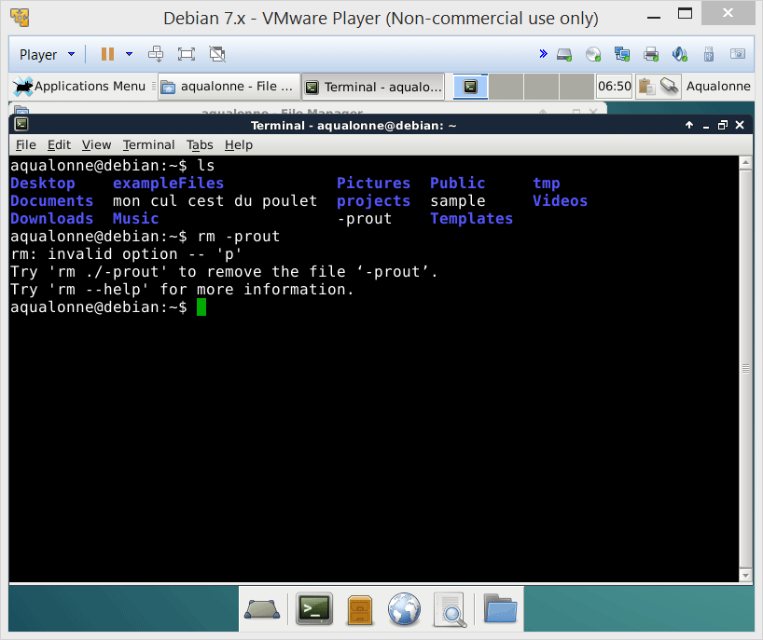

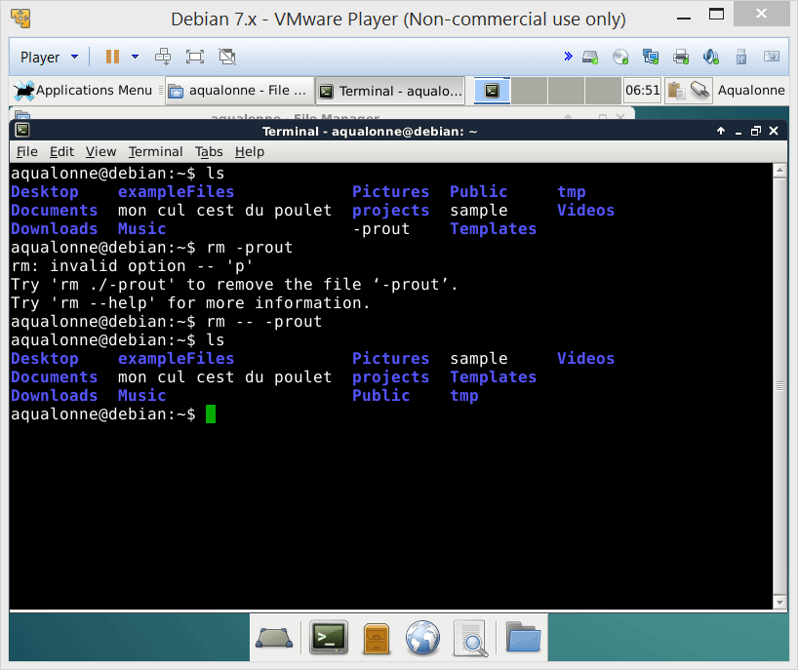
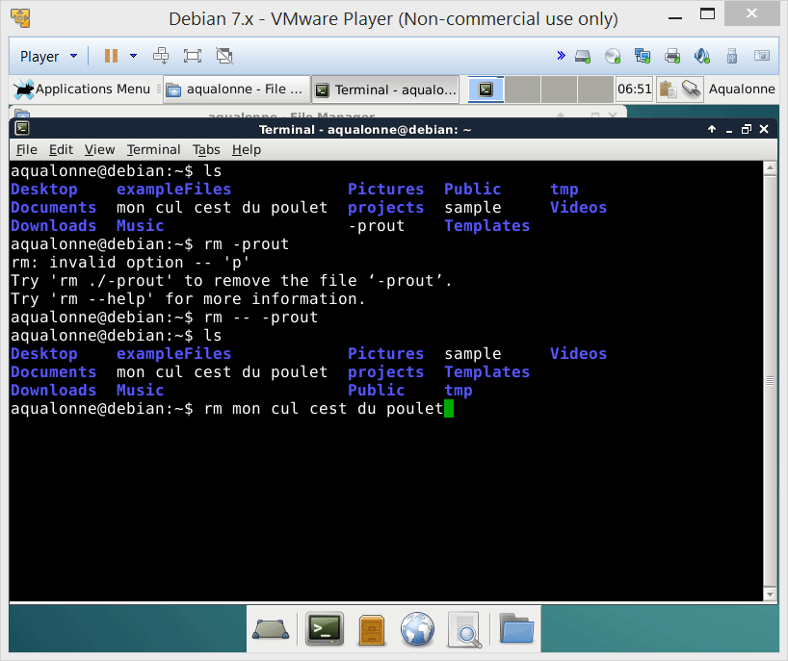
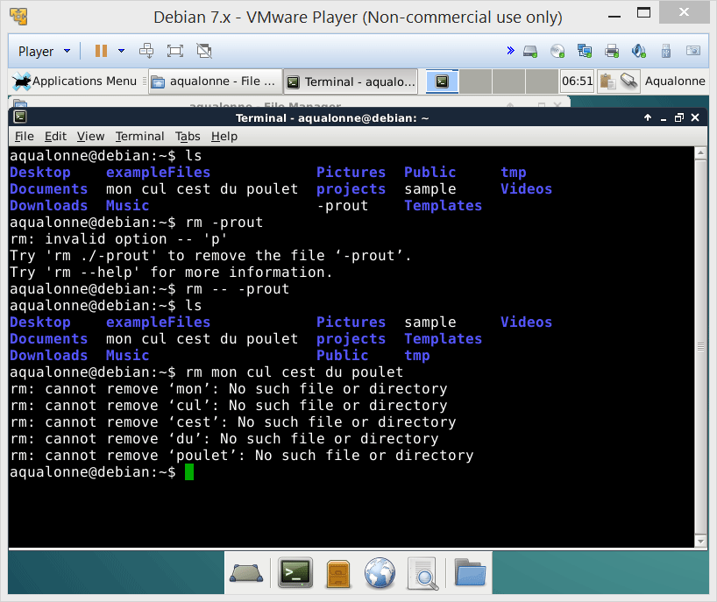
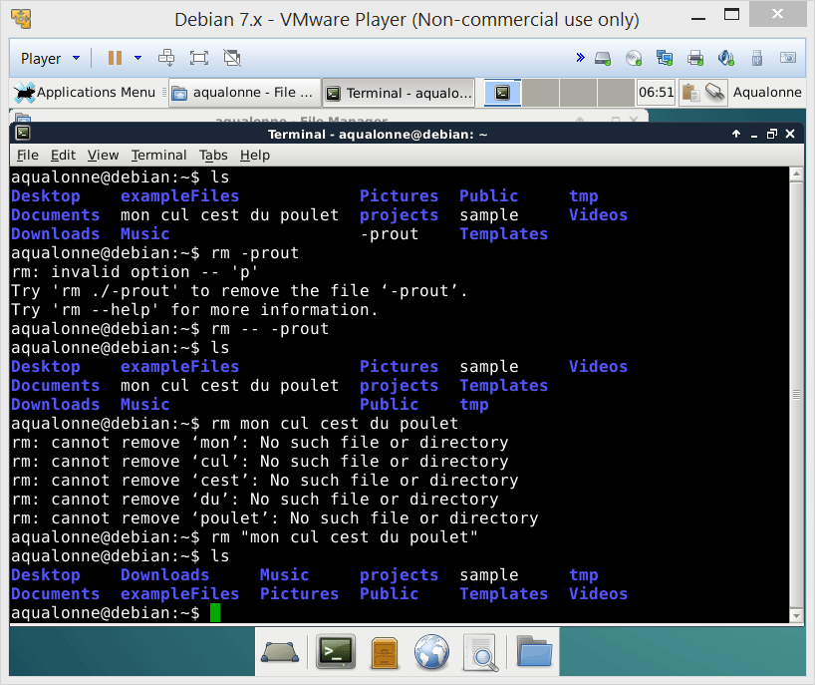

Removing files or directories
Be very careful about this: sending in invalid inputs can be done on purpose!
For more examples look at Code injection
on Wikipedia (Shell injection specifically)
15
Operations for directories and files

Slide 16
Overview of operations
Operations
Directories
Common to both
Files
Create
mkdir
Remove
rmdir
Remove
rm
Copy
cp
Move/rename
mv
Find
find
Link
ln
16
Operations for directories and files

Slide 17
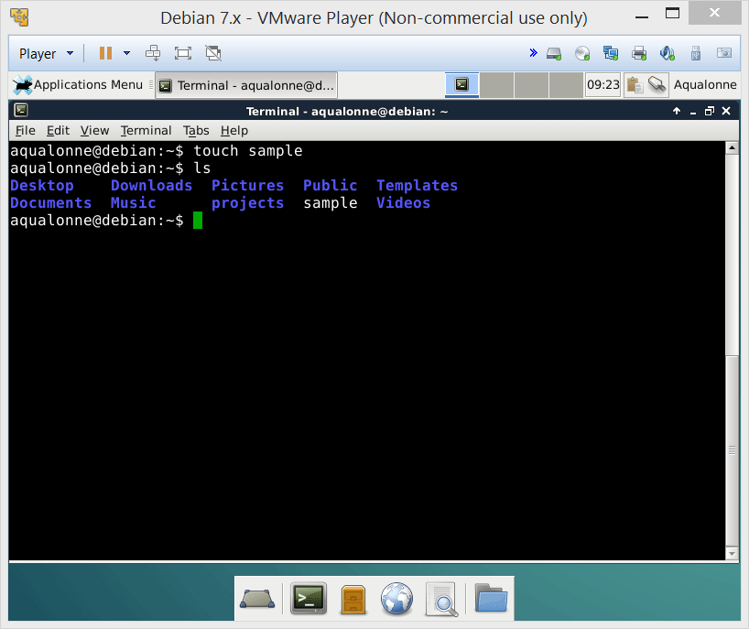
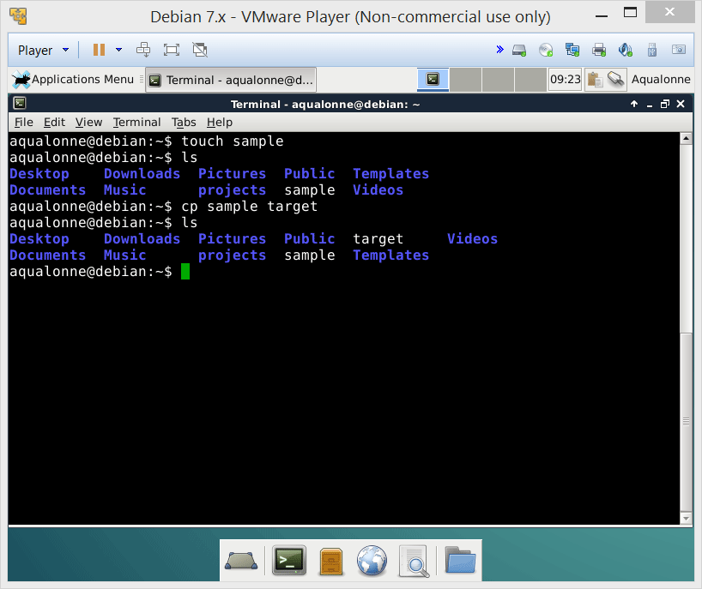
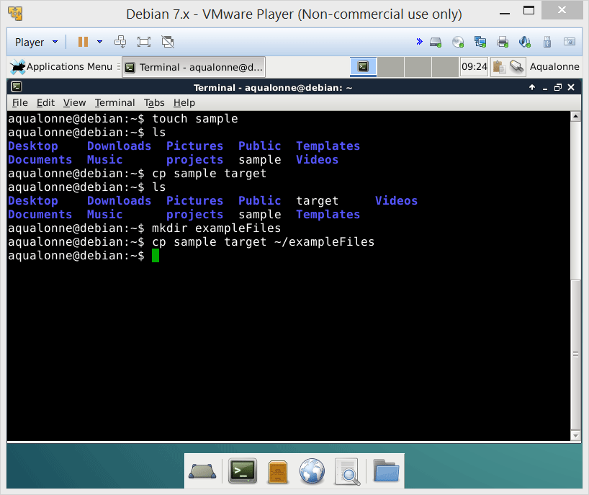
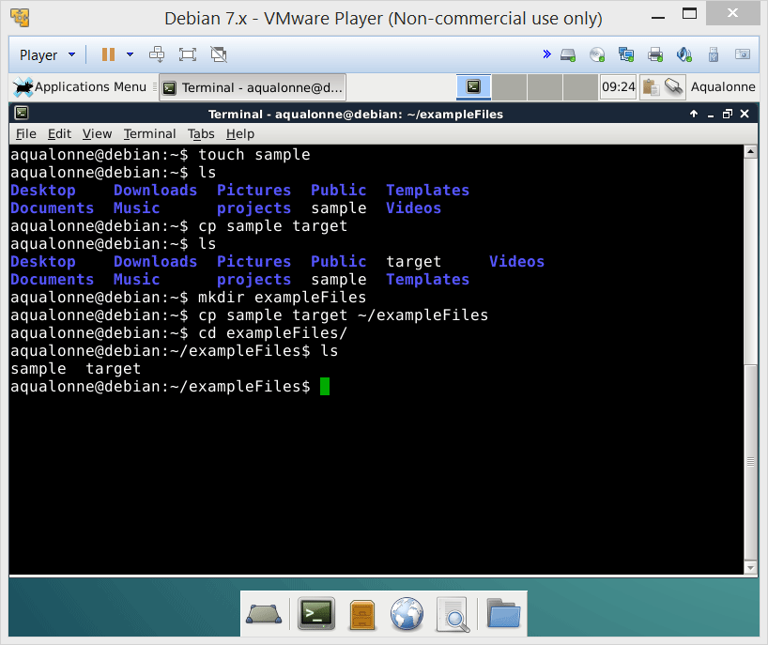
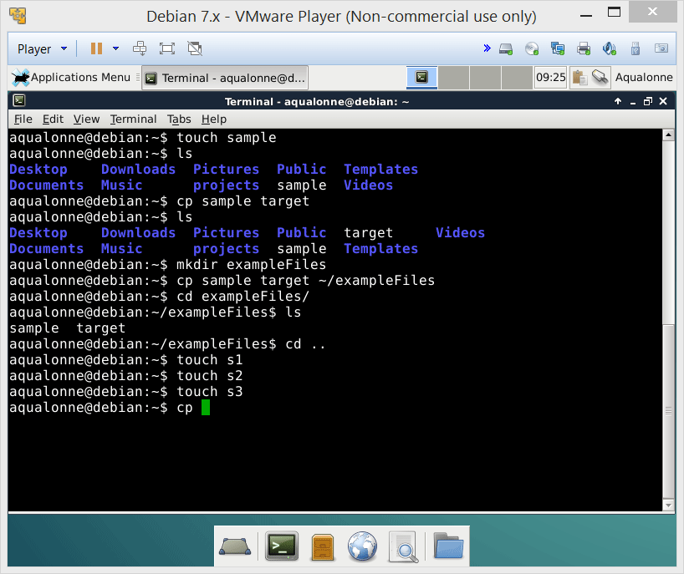
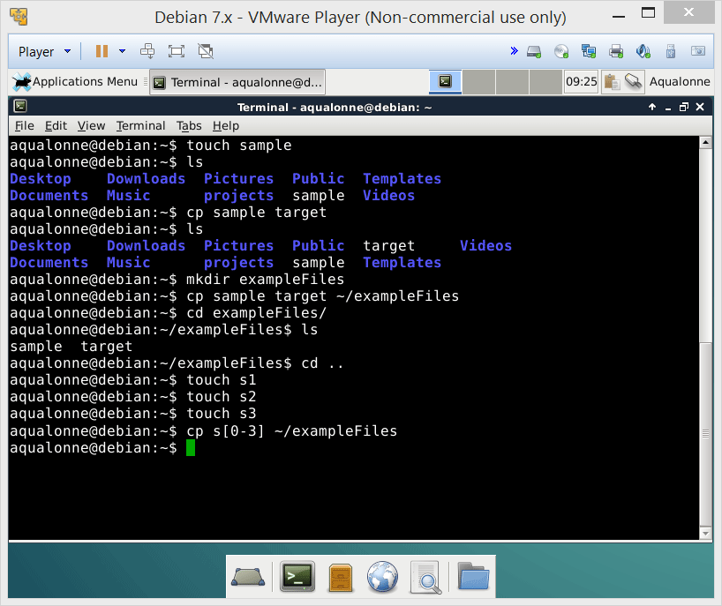

Copying files or directories
17
Operations for directories and files

Slide 18
Copying files or directories
cp source source source target
You can copy multiple files at the same time.
Either list them all, or use pattern matching.
-i Asks for confirmation if the target already exists
-p Preserves permissions and modification times
-r Recursively copies a folder and its subfolders
18
Operations for directories and files

Slide 19
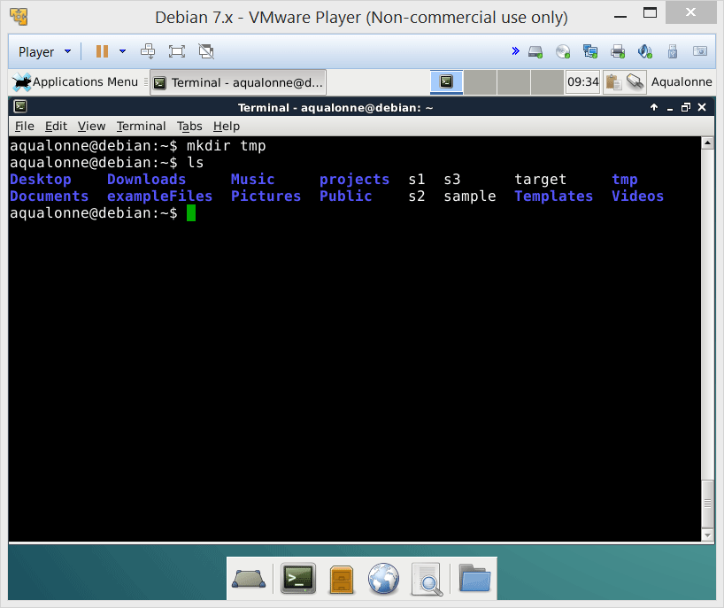
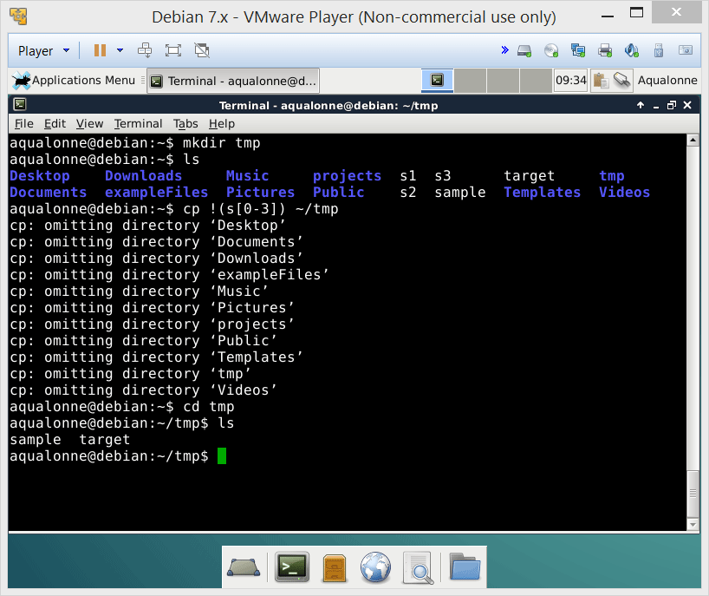
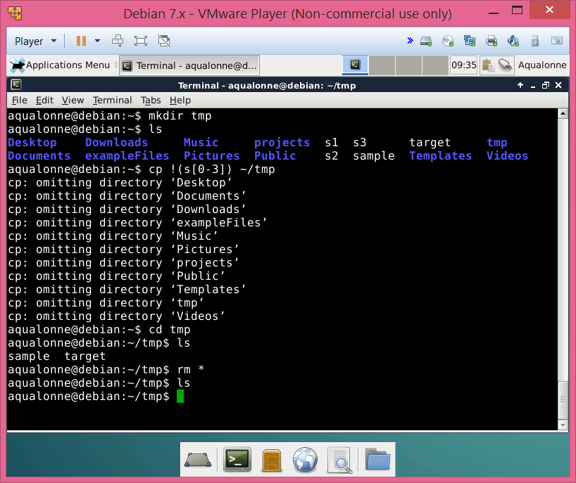
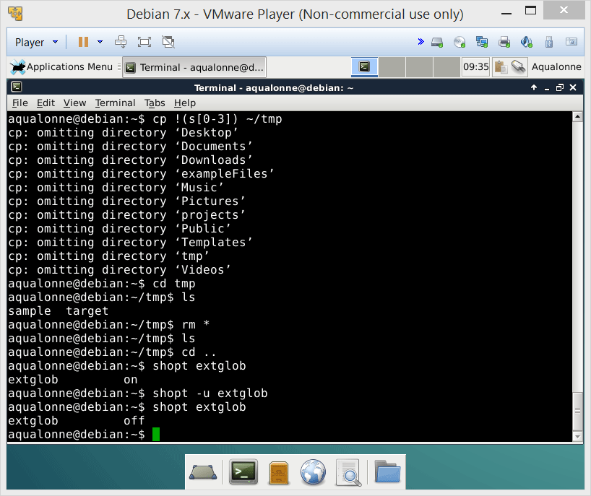
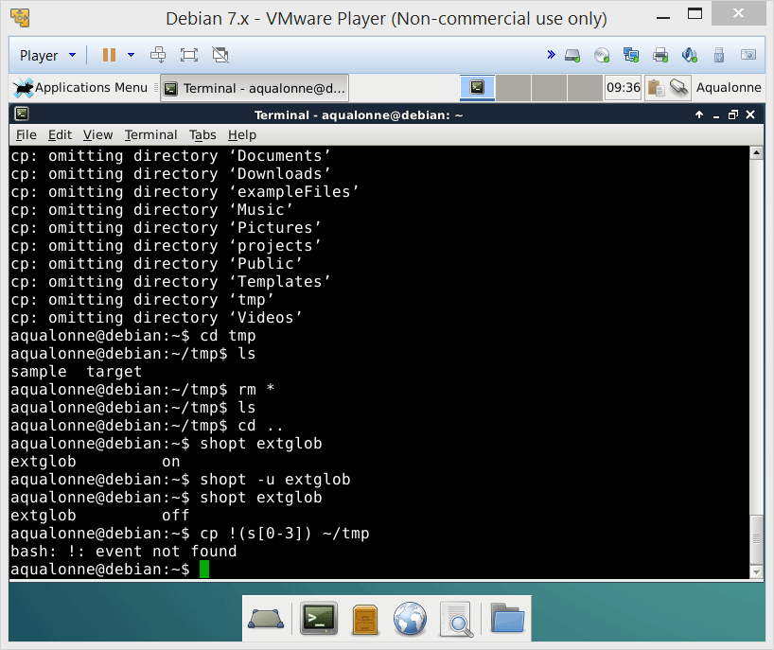
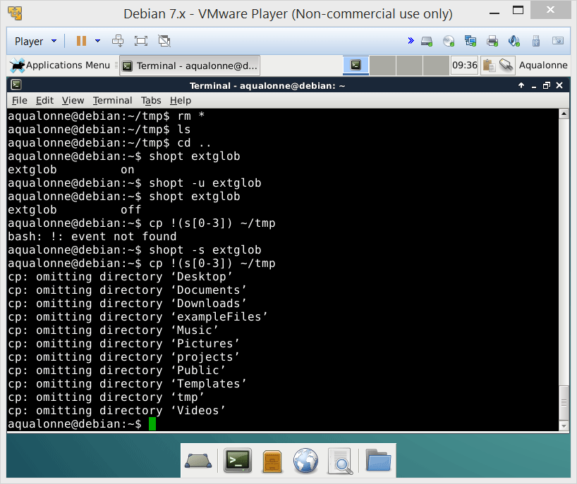
Copying files or directories
19
Operations for directories and files

Slide 20
Copying files or directories
If you want more powerful pattern matching options (such as specifying what you don’t wish to copy), use
shopt -s extglob
Some of the additional options you get will include:
! Match anything but...
@ Match exactly one
+ Match one or more
20
Operations for directories and files

Slide 21
Overview of operations
Operations
Directories
Common to both
Files
Create
mkdir
Remove
rmdir
Remove
rm
Copy
cp
Move/rename
mv
Find
find
Link
ln
21
Operations for directories and files

Slide 22








Moving/renaming files or directories
22
Operations for directories and files

Slide 23
Moving/renaming files or directories
mv source source source target
You can move multiple files at the same time.
Either list them all, or use pattern matching.
Can be a folder and/or the new name of the file
If the new name happens to also be the name of a folder, then the file is moved into the folder instead of being renamed.
23
Operations for directories and files

Slide 24



Moving/renaming files or directories
Trashcan
mv / /dev/null
Root of the system
24
Operations for directories and files

Slide 25






Moving/renaming files or directories
25
Operations for directories and files

Slide 26



Moving/renaming files or directories
26
Operations for directories and files

Slide 27
Overview of operations
Operations
Directories
Common to both
Files
Create
mkdir
Remove
rmdir
Remove
rm
Copy
cp
Move/rename
mv
Find
find
Link
ln
27
Operations for directories and files

Slide 28


Finding files or directories
The find command lets you search using a lot of criteria such as when files were created, how deep in subfolders they might be, how big the files are, etc.
~
tmp
sample
exampleFiles
subtmp1
subtmp2
subtmp3
sample
sampleCopy
s1
s2
s3
sample
subsub
sample
sample
28
Operations for directories and files

Slide 29





Finding files or directories
29
Operations for directories and files

Slide 30
Finding files or directories
The find command lets you search using a lot of criteria such as when files were created, how deep in subfolders they might be, how big the files are, etc.
~
tmp
sample
exampleFiles
subtmp1
subtmp2
subtmp3
sample
sampleCopy
s1
s2
s3
sample
-mindepth 1 –maxdepth 3
subsub
sample
-mindepth 2 –maxdepth 2
sample
30
Operations for directories and files

Slide 31





Finding files or directories
31
Operations for directories and files

Slide 32

Finding files or directories
To search for files based on time, you have several ways.
-amin
within minutes
access
within hours
-atime
Time of last
within minutes
-cmin
change
within hours
-ctime
32
Operations for directories and files

Slide 33
Overview of operations
Operations
Directories
Common to both
Files
Create
mkdir
Remove
rmdir
Remove
rm
Copy
cp
Move/rename
mv
Find
find
Link
ln
33
Operations for directories and files

Slide 34

Symlinks and hard links
You can create links, just like you create shortcuts in Windows, or pointers in C/C++.
There are 2 types of links. Differences are important!!
Soft link
(or symlink)
Hard link
Points to a path (or place)
Chains the file
If you move the file...
It breaks ☹
It works ☺
If you copy over a file with the same name...
Points to the copy
Points to the old file
If you delete the file...
It breaks ☹
It works ☺
Linking to a different filesystem
Can be done
Cannot be done
34
Operations for directories and files

Slide 35



Symlinks and hard links
blah
Hard link
251
251
/blah/file
Symlink
piou
/blah/file
35
Operations for directories and files

Slide 36
Symlinks and hard links
Hard link
251
blah
251
/blah/file
322
You can’t really delete a file that’s got hard link(s). There is no ‘original’ file: all hard links are equally strong hooks on the file. Delete all hard links to really delete the file
file
36
Operations for directories and files

Slide 37










Symlinks and hard links
37
Operations for directories and files

Slide 38
Symlinks and hard links
For more about links, look at Wikipedia on Symbolic link and Hard link
38
Operations for directories and files

Slide 39
Overview of operations
Operations
Directories
Common to both
Files
Create
mkdir
Remove
rmdir
Remove
rm
Copy
cp
Move/rename
mv
Find
find
Link
ln
39
Operations for directories and files

Slide 40

40
Operations for directories and files

Slide 41

Practice questions & activities
We recommend that you do these, but that’s for your own good, not graded.
Create a hierarchy (using mkdir) of folders (e.g., 3 folders with each having multiple subfolders). Copy files (using cp) to several of these folders, then search for these files (using find).
Create a symlink and several hard links for a file (using ln). Then move (using mv) the file and see how the links behave. Finally, delete the hard links one after the other and see how the count of links changes (using ls -lia).
Search the internet to find out whether symlinks or hard links are faster to access a file. I won’t give you the answer to this one ☺
41
Operations for directories and files

